Slide 1


# Clap-Activated LED Circuit: A Fun Project
This presentation explores a simple yet engaging circuit that allows an LED to blink upon detecting a clap. A fun and educational project for beginners. Let's dive in!
by Parmar Dhruv

Slide 2

# Introduction: Making an LED Blink with a Clap
The core goal is to create a circuit. This circuit will activate an LED. The LED will blink when it "hears" a clap.

Slide 3

# Materials Needed
LED: Light Emitting Diode to blink.
Microphone: Sound sensor to detect clap.
Transistor: Amplifier of the signal.
Resistor: Controls current flow.
Capacitor: Stores energy temporarily.
Power Supply: Source of electrical power.
Breadboard: Platform for circuit assembly.
Jumper Wires: Connecting the components.

Slide 4


Slide 5
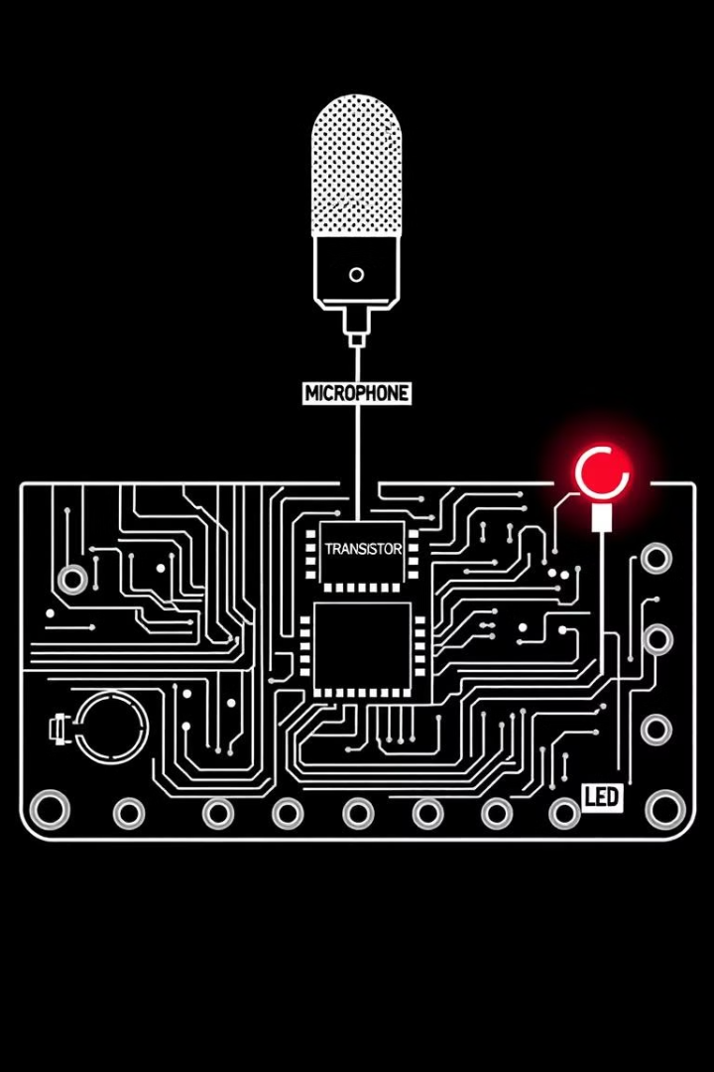
# How it Works: Functionality and Components
The microphone detects the clap. This signal is amplified by the transistor. The amplified signal then triggers the LED to blink.
The components work together for a simple but effective mechanism.

Slide 6
# Building the Circuit: Step-by-Step
Place the microphone on the breadboard.
Connect the resistor to the microphone and transistor.
Place transistor on the breadboard and connect it to LED.
Connect the LED and ensure the polarity is correct.
Power the circuit with the power supply.

Slide 7
# Testing and Troubleshooting: Debugging Tips
If the LED doesn't blink, check the connections. Also, verify the power supply is working correctly. Check the polarity of the LED.
Ensure all components are functioning.

Slide 8

# Conclusion and Further Exploration
The clap-activated LED circuit is a great start. You can experiment with different components. Try different sensors and more complex circuits!
Learn more about the electronic components and sensors.

